Slide 1

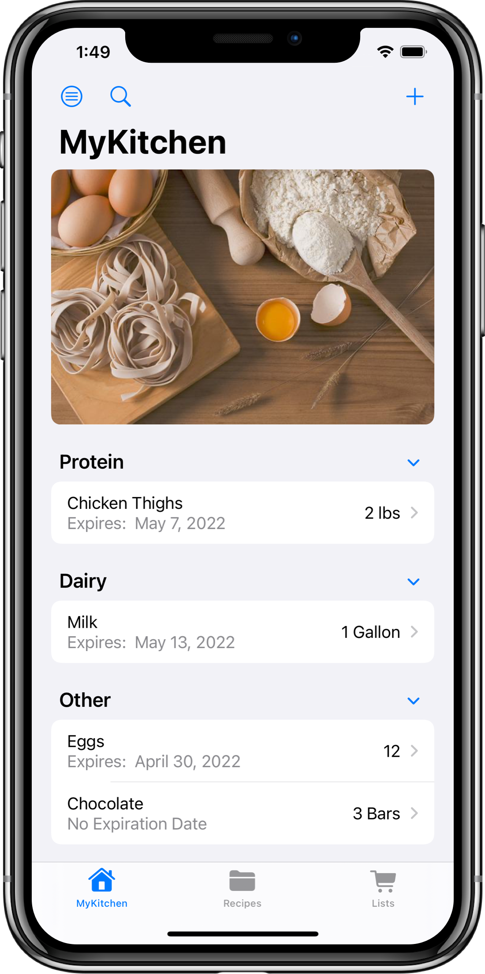
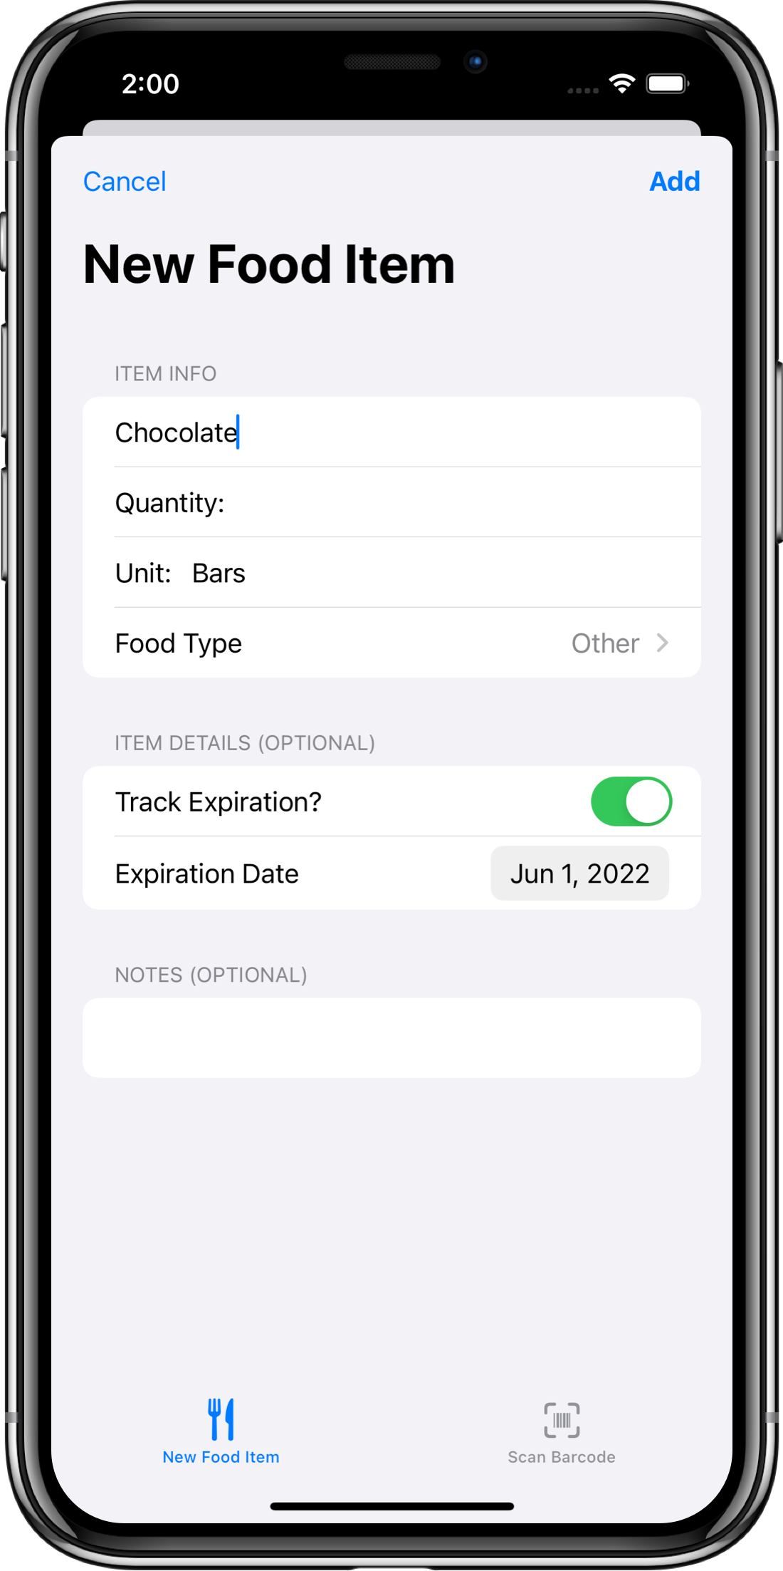
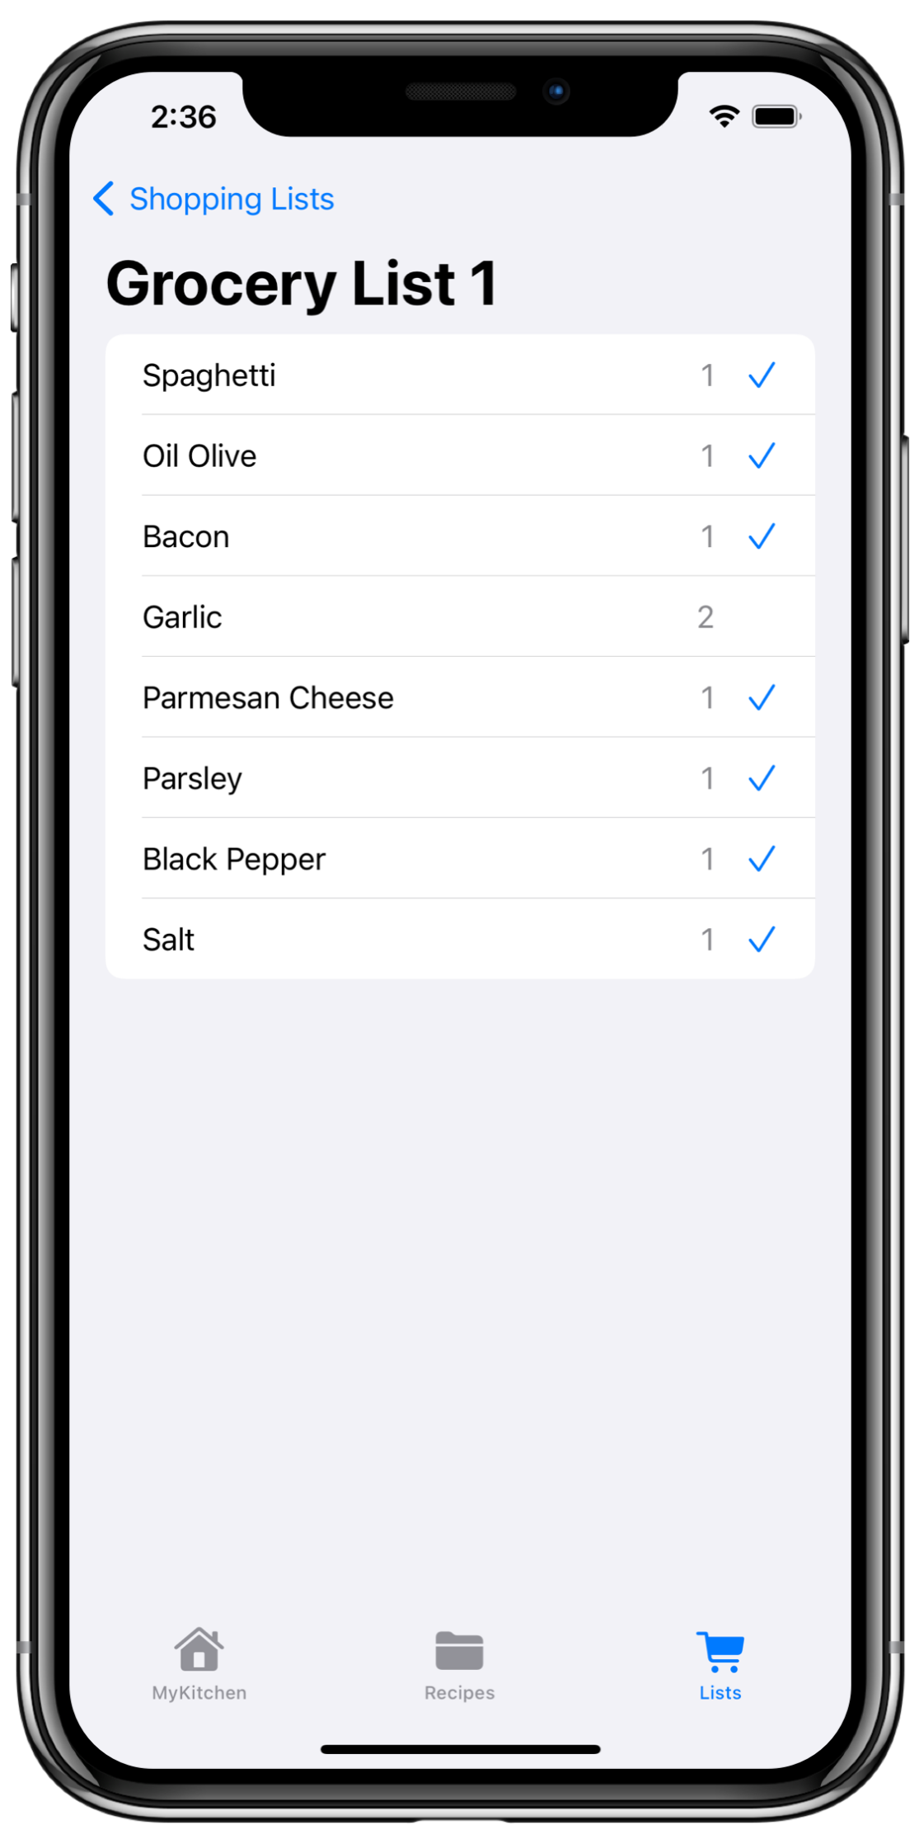
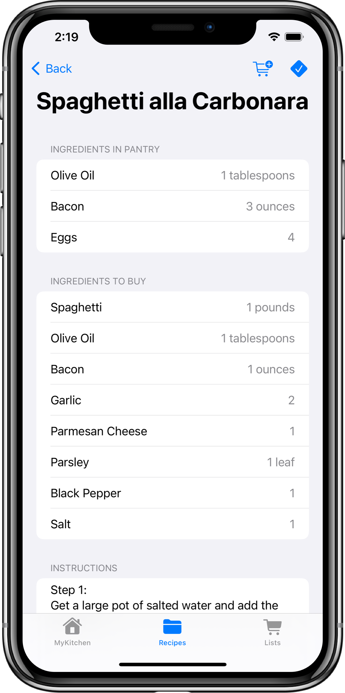
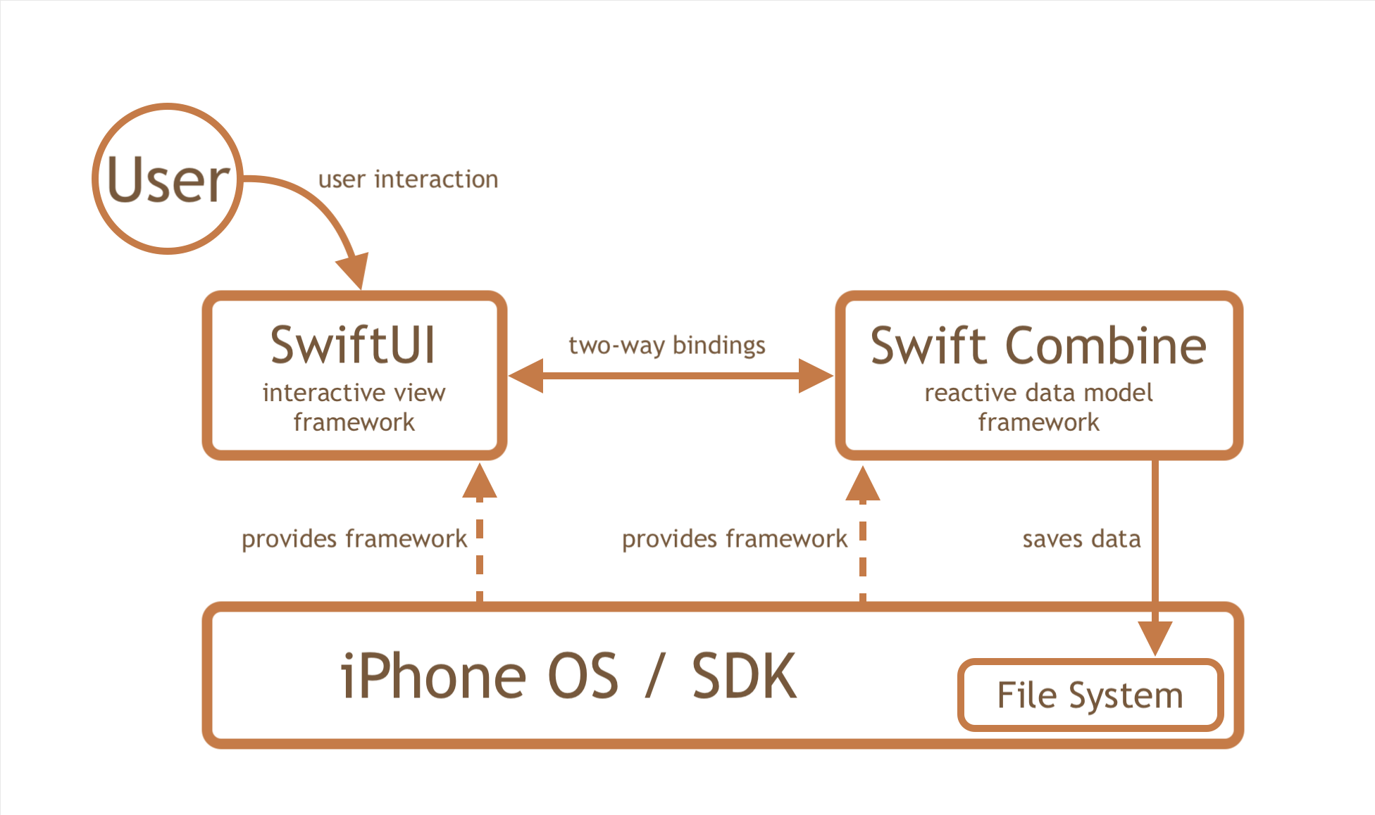
CS 4485 / Spring 2022
Erik Jonsson School of Engineering & Computer Science
The University of Texas at Dallas
Richardson, TX 75080, USA
MyKitchen Mobile App
MyKitchen Team
Project Sponsor
Venkata S. Vadlamani
Faculty Advisors
Dr. Miguel Razo-Razo
Dr. Jeyakesavan Veerasamy
Elliott Gorman
Elliott.Gorman@utdallas.edu
Thinh Le
Thinh.Le@utdallas.edu
Krish Suchdev
Krish.Suchdev@utdallas.edu
Rowenna Switzer
Rowenna@utdallas.edu
Garrett Griffiths
Garrett.Griffiths@utdallas.edu
Abstract
The MyKitchen app was designed to address the issue of food inventory management within household environments. We aimed to address the issue of forgetting precisely what food items one has and where it is stored, and how it could be used. As such, we developed an app that allows users to keep a running inventory of their food and a digital recipe book that accounts for current inventory and cooking options. To better support both functionalities, we included a shopping list section to easily keep track of what a user intends to buy on their next outing. We successfully managed to meet both of our deliverable goals: we have developed an app that allows a user to track and manage a pantry to use with various features, and the app is in a nearly-shippable state following some minor adjustments to the functionality of the app.
Keywords: SwiftUI, iOS, Reactive, Database, Swift
MyKitchen Pantry View
New Food
View
Shopping List View
Recipe Detail View
Architecture
Results and Future Work
Results
With the MyKitchen app, people can rest easy knowing they do not have to monitor their pantry manually. We’ve included many useful features to support this, including:
Users will be able to see what is in their pantry, at any time, anywhere.
Users may check for missing ingredients of a recipe at the click of a button, and have those ingredients automatically sent to a shopping list.
Users may enter in items manually or use the barcode scanning feature to scan a barcode which does a simple look-up to automatically fill in the form fields of a new food item.
Future Work
Future work includes the addition of features to improve the use cases of the app and quality of life changes that increase the user experience. As of now, we plan to improve the app to include the following features:
Allow multiple users to share a pantry so each household has a single MyKitchen pantry.
Integrate shopping lists with Grocer APIs to allow users to automatically transfer their list to their preferred grocer website.
Further integrate barcode scanning and allow nutritional label scanning and other methods to make data entry easier.
Incorporate Smart Assistants such as Siri
Impact on Users
Performance Metrics
Ease of Finding Items
As items are stored in the MyKitchen pantry, users can easily see what items they have, and what items they don’t have.
Ease of Recipe Item Checking
Users can see what items they don’t have and what items they do have with the tap of a button.
Shareable Pantries / Easy Shopping
Future work will include shareable pantries, allowing users to share the same pantry, as well as see their friend’s pantries and shopping lists. This collaboration will allow users to easily manage group tasks in the kitchen, as well as what to bring to the next gathering.
Grocery APIs
Future work will include the use of Grocery APIs so that users can easily export their shopping lists to their preferred grocer.
Do the features implemented meet our original goals/expectations?
Features implemented were successfully developed to meet our vision for the project. While we are not finished with this project and plan on continuing development on many features, those completed have met our initial expectations.
Were we able to meet our weekly goals? Members were able to complete their weekly goals by ensuring work distributed was given with realistic and reasonable expectations. Through risk management, we accounted for emergency situations (accounting for scenarios such as COVID or family emergencies), ensuring everything was performed on time even in such occasions.
Were we able to implement each feature without creating numerous bugs? Development of features was handled with care and respect to other portions of the app and proved to help reduce the complexity of resolving merge conflicts and avoid problematic errors in code. As a result of these good practices, most features have been implemented without problems concerning erroneous code.

